Slide 1


Deep Convolutional Network for Object Detection
R-CNN : Rich Feature Hierarchies for Accurate Object Detection and Semantic Segmentation
Ross Girshick, Jeff Donahue, Trevor Darrell, Jitendra Malik
Fast R-CNN : Fast Region-based Convolutional Network method (Fast R-CNN) for object detection
Ross Girshick
Faster R-CNN : Towards Real Time Object Detection with Region Proposal Network
Shaoqing Ren, Kaoming He, Ross Girshick, and Jian Sun
by
Poornank Purohit
San Francisco State University
Fall Semester, 2022

Slide 2

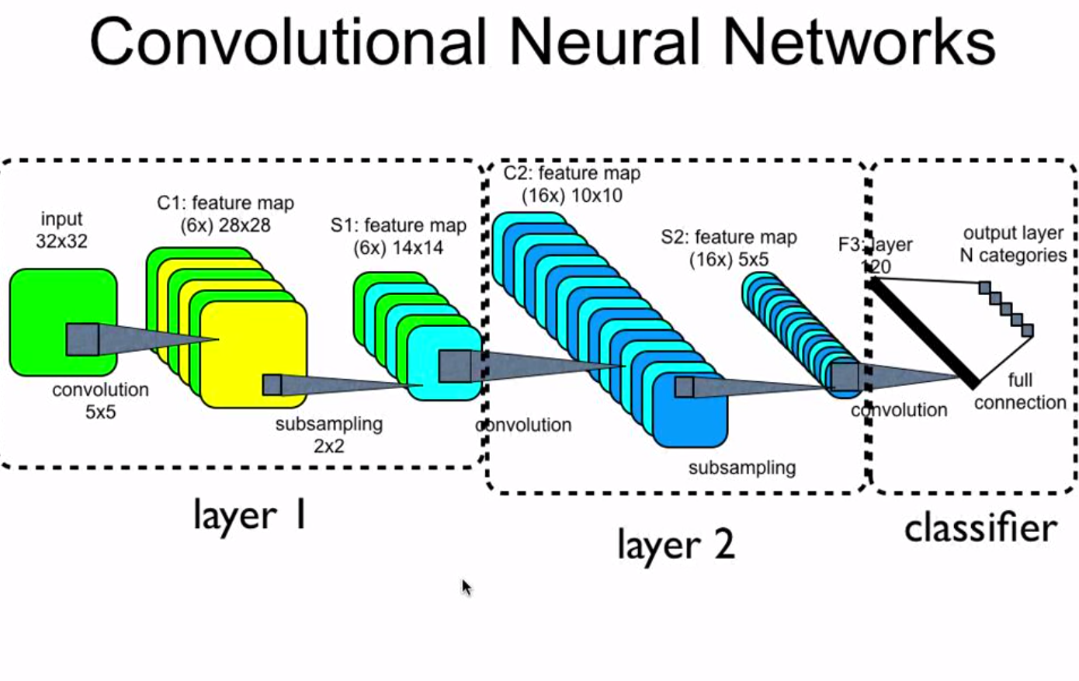
Region Proposal : CNN
An Image is passed through multiple convolutional and pooling layers to get output in the form of object's class. For each input image, we get corresponding class as an output.

Slide 3
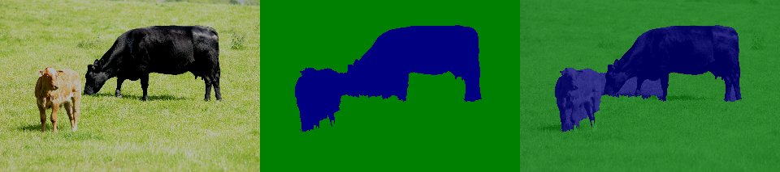
Region Proposal : R-CNN
You could run the algorithm convolutionally but one downside to the algorithm is complex computational time.
A better algorithm was proposed called R-CNN, which tries to pick the regions to run the classifier on based on semantic and instance segmentation.
[Girshik et. Al, 2013, Rich Features Hierarchies for Accurate Object Detection and Semantic Segmentation]

Slide 4
Region Proposal : R-CNN
Region Proposal is run by an algorithm called Segmentation algorithm that results in the output to figure what could be potential objects.
This algorithm is run not only square shaped blobs but also on different sized and different dimensioned images.
[Girshik et. Al, 2013, Rich Features Hierarchies for Accurate Object Detection and Semantic Segmentation]

Slide 5
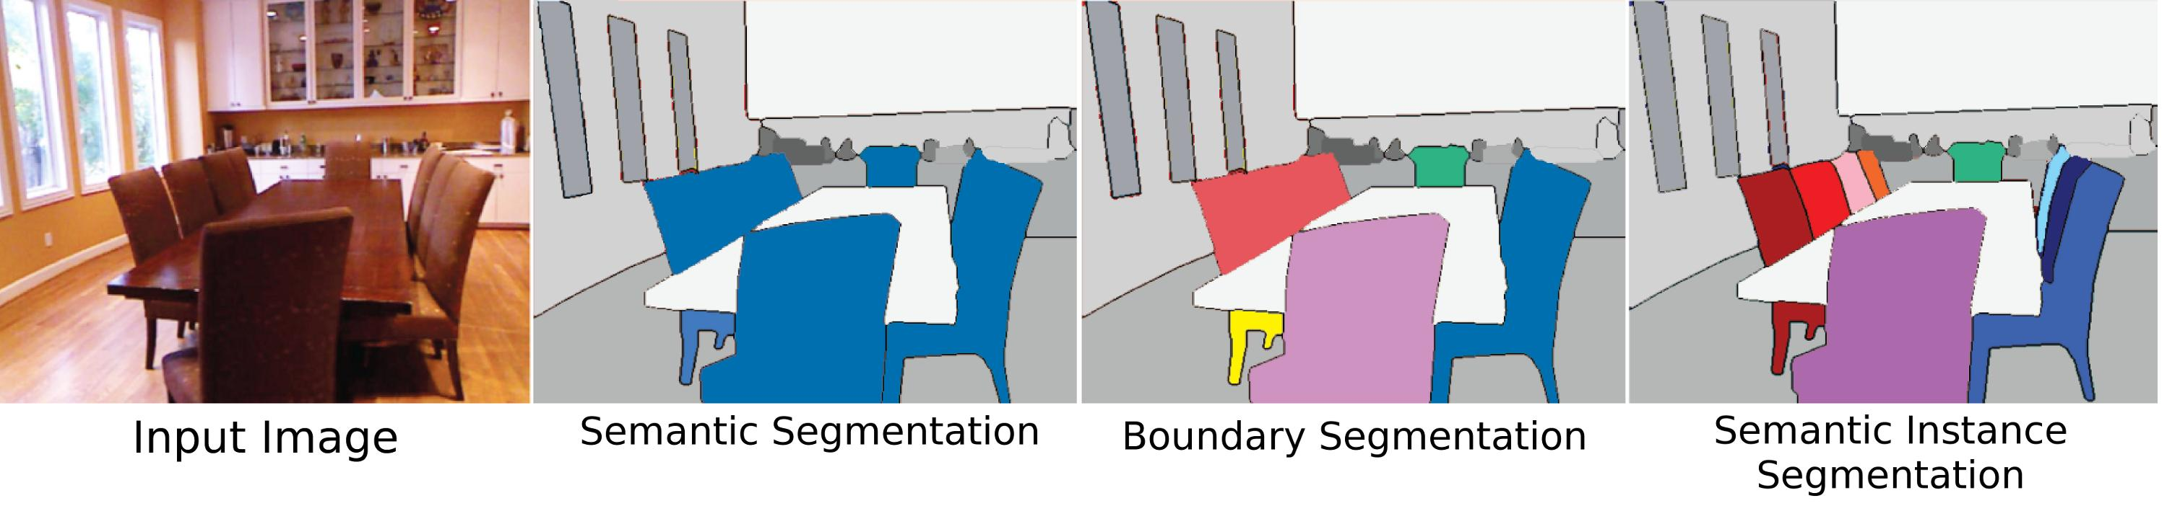
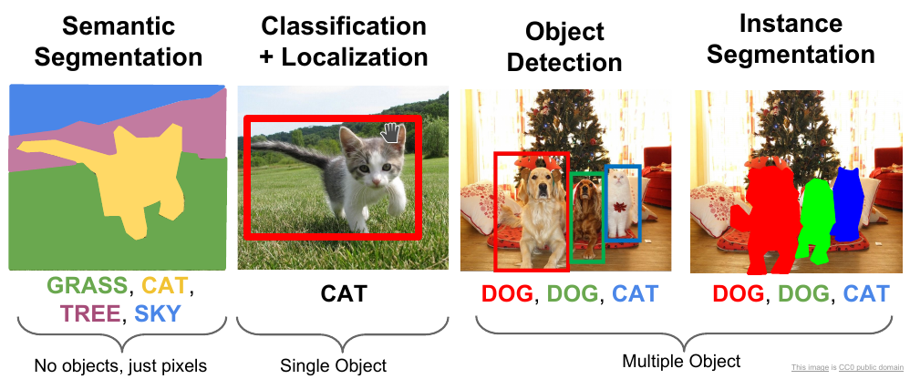
Region Proposal : R-CNN
One of the important stage of object detection in image segmentation is selective search.
From Semantic segmentation, boundary is created to differentiate between different colored textures.
[Girshik et. Al, 2013, Rich Features Hierarchies for Accurate Object Detection and Semantic Segmentation]

Slide 6
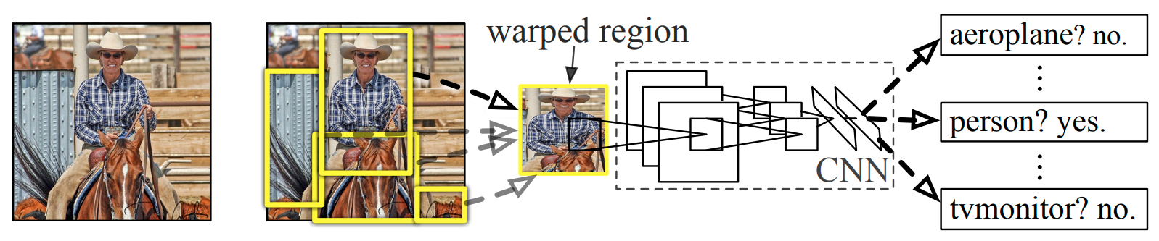
Region Proposal : R-CNN
From input image after applying selective search, we get bounding box which are cropped and passed in a CNN network.
After image segmentation the image with bounding boxes are then passed into CNN network to predict the class and bounding boxes.
[Girshik et. Al, 2013, Rich Features Hierarchies for Accurate Object Detection and Semantic Segmentation]

Slide 7
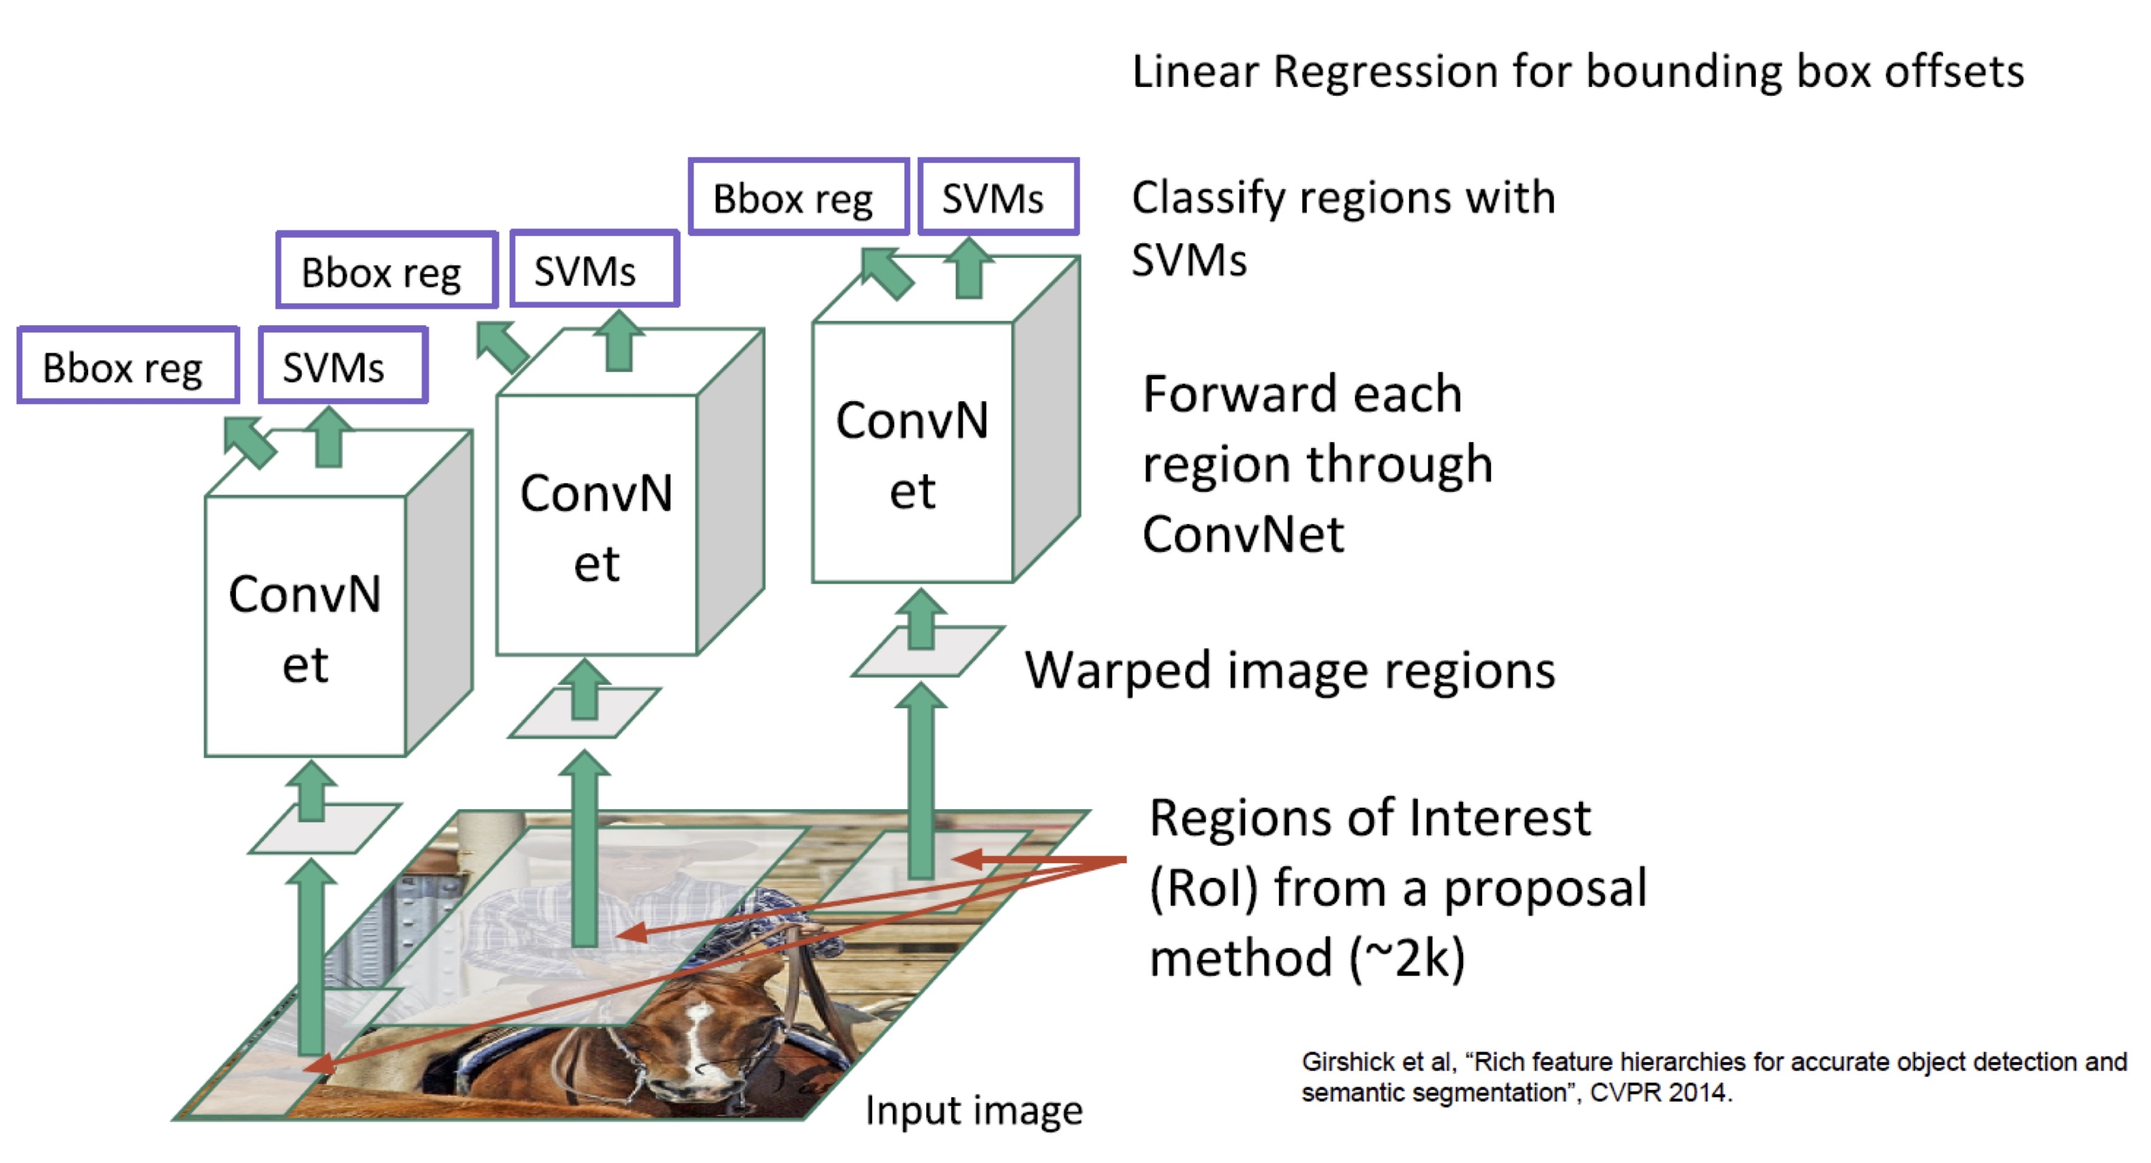
Region Proposal : R-CNN
One of the downside of R-CNN was it takes fixed sized input which had to be done multiple times resulting in more computational time.
[Girshik et. Al, 2013, Rich Features Hierarchies for Accurate Object Detection and Semantic Segmentation]

Slide 8
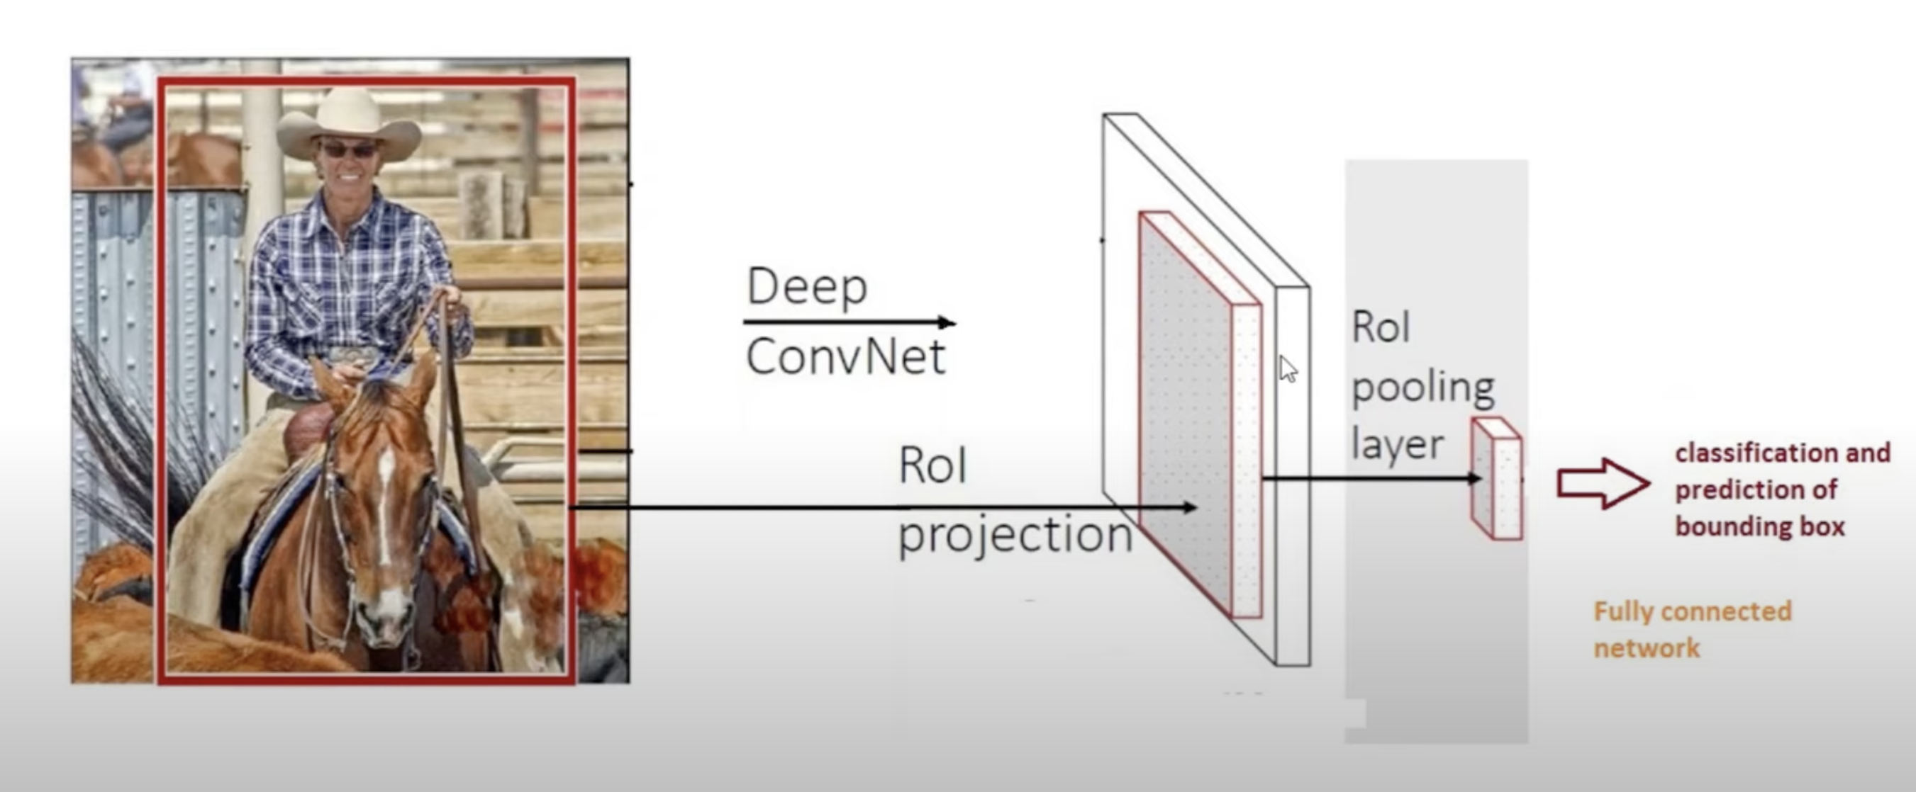
Region Proposal : Fast R-CNN
In Fast R-CNN, the entire image with bounding boxes are passed in through Deep Convolutional Network which gives us output in feature map also known as RoI (Region of Interest) projection.
The values from CNN Network to RoI projection are passed through RoI pooling layer by fixing its size as its fully connected network which classifies the given image with its bounding boxes.
[Fast R-CNN : Fast Region-based Convolutional Network method (Fast R-CNN) for object detection - Ross Girshick]

Slide 9
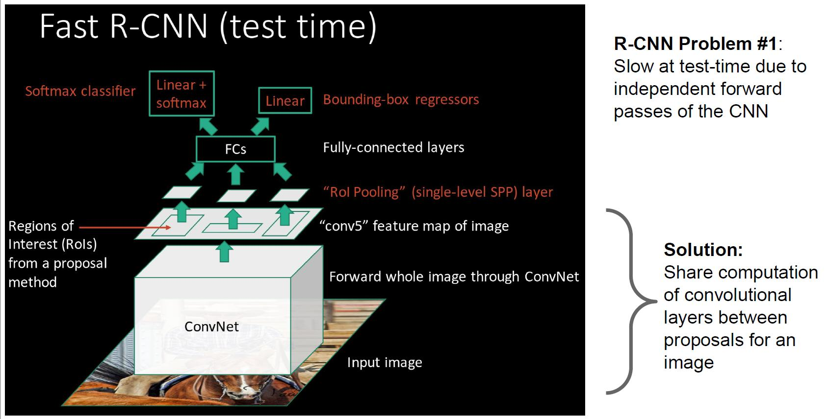
Region Proposal : Fast R-CNN
[Fast R-CNN : Fast Region-based Convolutional Network method (Fast R-CNN) for object detection - Ross Girshick]

Slide 10
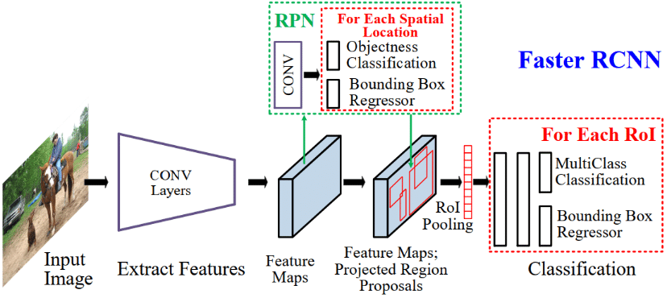
Region Proposal : Faster R-CNN
Here the projection on feature map is from RPN (region proposal network) unlike Fast R-CNN which was from selective search.
It predicts the bounding box from feature maps with classifying if object is present or not by passing it through convolutional network.
[Ren et. Al, 2016. Faster R-CNN : Towards real-time object detection with region proposal networks]

Slide 11
Region Proposal : Faster R-CNN
Once the bounding boxes are detected into feature maps it pools all different sized bounded boxes into sized fixed via RoI pooling.
[Ren et. Al, 2016. Faster R-CNN : Towards real-time object detection with region proposal networks]

Slide 12
Region Proposal : Fast R-CNN
CNN : Divides the image into multiple regions and then classify each region into various classes.
R-CNN : Uses selective search to generate regions. Extracts around 2000 regions from each image.
Fast R-CNN : Each image is passed only once to the CNN and feature maps are extracted. Selective search is used on these maps to generate predictions. Combines all the three models used in RCNN together.
Faster R-CNN : Replaces the selective search method with region proposal network which made the algorithm much faster.
[Girshik et. Al, 2013. Rich feature hierarchies for accurate object detection and semantic segmentation]
[Fast R-CNN : Fast Region-based Convolutional Network method (Fast R-CNN) for object detection - Ross Girshick]
[Ren et. Al, 2016. Faster R-CNN : Towards real-time object detection with region proposal networks]

